Slide 1

Predicting the Winner of NFL-Games using Elo Rating
http://www.free-powerpoint-templates-design.com

Slide 2

Overview
Introduction/Background
Methodology
Results
Conclusion

Slide 3

Introduction
NFL Game Predictions
$90 billion in bets
Vast release of information
Beating the experts
Elo Rating System
Developed by Arpad Elo
First applied to single player games
Later used for team sports

Slide 4
Methodology

Slide 5
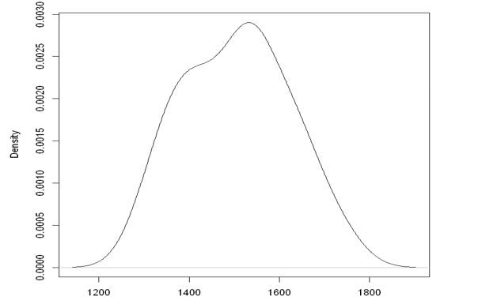
Dataset 1 – Initial Elo Ratings
team | elo |  | team | elo
KC | 1,744.77 |  | BUF | 1,514.53
BAL | 1,705.15 |  | TB | 1,495.44
NO | 1,662.21 |  | DEN | 1,490.99
SF | 1,653.18 |  | IND | 1,471.48
TEN | 1,646.16 |  | LAC | 1,453.09
GB | 1,621.19 |  | NYJ | 1,434.60
NE | 1,619.80 |  | ARI | 1,411.48
MIN | 1,604.21 |  | CLE | 1,408.30
LAR | 1,569.85 |  | JAX | 1,405.25
SEA | 1,567.85 |  | OAK | 1,403.49
ATL | 1,549.27 |  | CAR | 1,374.10
DAL | 1,545.67 |  | MIA | 1,368.38
PHI | 1,540.34 |  | DET | 1,354.35
HOU | 1,539.40 |  | NYG | 1,334.11
CHI | 1,534.35 |  | CIN | 1,321.44
PIT | 1,515.06 |  | WSH | 1,300.24
Distribution of Initial Elo Ratings
Elo Rating

Slide 6
Dataset 2 – Regular Season Schedule
date | team1 | team2 | score1 | score2
9/10/2020 | KC | HOU | 34 | 20
9/13/2020 | CAR | OAK | 27 | 20
9/13/2020 | ATL | SEA | 23 | 27
9/13/2020 | BAL | CLE | 21 | 11
9/13/2020 | NE | MIA | 30 | 34
9/13/2020 | JAX | IND | 38 | 6
---- | ---- | ---- | ---- | ----
1/3/2021 | BUF | MIA
1/3/2021 | KC | LAC
1/3/2021 | PHI | WSH
1/3/2021 | SF | SEA
1/3/2021 | DEN | OAK
1/3/2021 | LAR | ARI

Slide 7
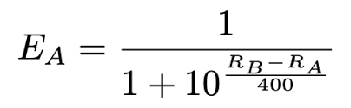
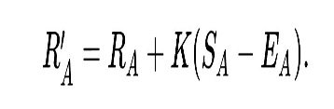
Methodology
Elo Calculation Cycle
Adjustments
Calculate Post-game Elo Ratings
Pre-game Elo Ratings
Calculate Win Probabilities
Compare to Actual Results
Post-game Elo rating from previous week (for week 1 use final Elo from 2019 Season)
Add additional 35 points for home field advantage
Formula 1:
Home Win = 1
Home Loss = 0
Formula 2:

Slide 8
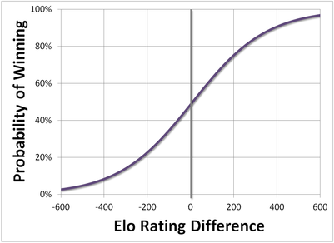
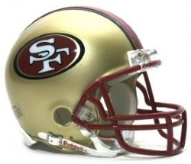
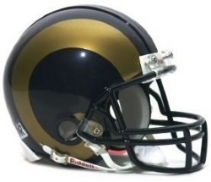
Week 6: San Francisco 49ers vs Los Angeles Rams
week | date | team1 | team2 | score1 | score2 | actual_ outcome | elo1_pre | elo2_pre | elo1_prob | elo2_prob | pred_ outcome | elo1_post | elo2_post
6 | 10/18/2020 | SF | LAR | 24 | 16 | 1 | 1,613 | 1,586 | 67% | 33% | 1 | 1,620 | 1,580
vs

Slide 9
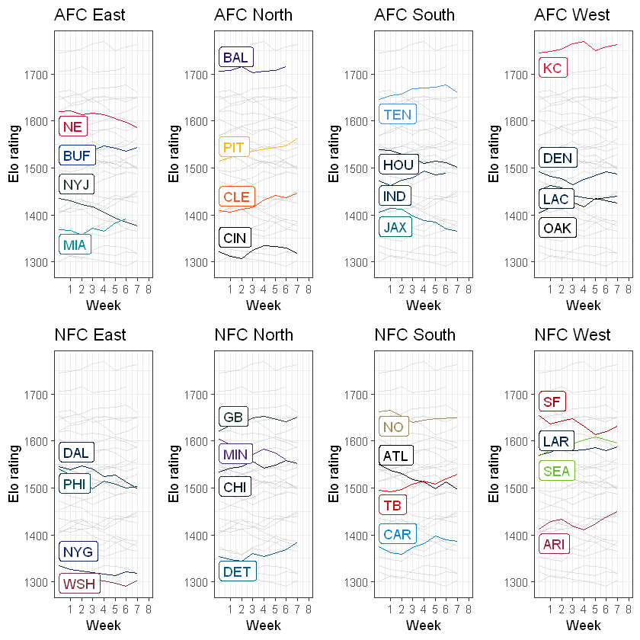
NFL Elo Ratings through Week 7

Slide 10
Application: Week 8 Predictions
week | team1 | elo1_pre | elo1_prob |  | team2 | elo2_pre | elo2_prob |  | pred_win
8 | CAR | 1,386.56 | 48.63% |  | ATL | 1,496.07 | 51.37% |  | ATL
8 | CIN | 1,318.92 | 19.97% |  | TEN | 1,660.06 | 80.03% |  | TEN
8 | KC | 1,762.43 | 94.26% |  | NYJ | 1,376.26 | 5.74% |  | KC
8 | CLE | 1,445.77 | 66.74% |  | OAK | 1,424.76 | 33.26% |  | CLE
8 | GB | 1,650.69 | 74.94% |  | MIN | 1,560.39 | 25.06% |  | GB
8 | BUF | 1,543.94 | 58.40% |  | NE | 1,585.03 | 41.60% |  | BUF
8 | MIA | 1,390.42 | 36.50% |  | LAR | 1,586.60 | 63.50% |  | LAR
8 | DET | 1,383.99 | 49.31% |  | IND | 1,488.80 | 50.69% |  | IND
8 | BAL | 1,714.70 | 80.96% |  | PIT | 1,563.28 | 19.04% |  | BAL
8 | DEN | 1,485.98 | 69.97% |  | LAC | 1,439.05 | 30.03% |  | DEN
8 | CHI | 1,550.93 | 50.29% |  | NO | 1,648.89 | 49.71% |  | CHI
8 | SEA | 1,595.93 | 59.12% |  | SF | 1,631.81 | 40.88% |  | SEA
8 | PHI | 1,503.65 | 64.66% |  | DAL | 1,498.68 | 35.34% |  | PHI
8 | NYG | 1,317.44 | 34.44% |  | TB | 1,529.24 | 65.56% |  | TB

Slide 11


Top Elo Ratings as of Week 7
Rank | Team | Elo Rating
1 | KC | 1,762
2 | TEN | 1,660
3 | GB | 1,651
4 | NO | 1,649
5 | SF | 1,632
6 | SEA | 1,596
7 | LAR | 1,587
8 | NE | 1,585
9 | PIT | 1,563
10 | CHI | 1,551
11 | BUF | 1,544
12 | TB | 1,529
vs.

Slide 12
Results and Conclusion

Slide 13
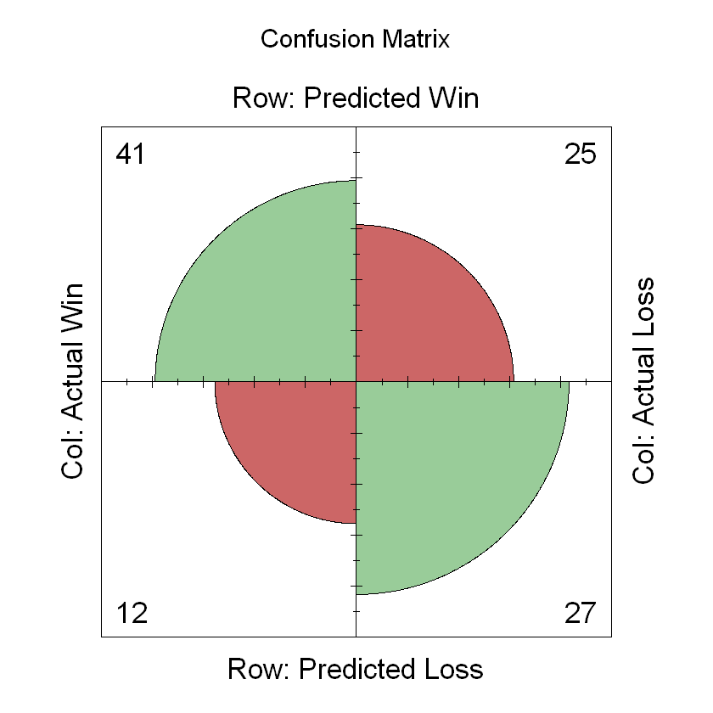
Results
Accuracy: 0.6476
NPV: 0.6923
Sensitivity: 0.7736
PPV: 0.6212
Specificity: 0.5192
TP
FP
FN
TN

Slide 14
Conclusion
FiveThirtyEight Accuracy ~ 65%
This Study’s Accuracy – 64.76%

Slide 15
References
Alvarez, R. (2020). Machine Learning Playoff Predictions: Predicting the Football Greats.
Balreira, E. C., & Miceli, B. K. (2019). Improving Foresight Predictions in the 2002-2018 NFL Regular-Seasons: A Classic Tale of Quantity vs. Quality. Journal of Advances in Mathematics and Computer Science, 1-14.
Bonds-Raacke, J. M., Fryer, L. S., Nicks, S. D., & Durr, R. T. (2001). Hindsight bias demonstrated in the prediction of a sporting event. The Journal of social psychology, 141(3), 349-352.
Boulier, B. L., & Stekler, H. O. (2003). Predicting the outcomes of National Football League games. International Journal of forecasting, 19(2), 257-270.
Bosch, P. (2018). Predicting the winner of NFL-games using Machine and Deep Learning.
Harville, D. (1980). Predictions for National Football League games via linear-model methodology. Journal of the American Statistical Association, 75(371), 516-524.
Klein, J., Frowein, A., & Irwin, C. (2018). Predicting Game Day Outcomes in National Football League Games. SMU Data Science Review, 1(2), 6.
Lee, M. D., Danileiko, I., & Vi, J. (2018). Testing the ability of the surprisingly popular method to predict NFL games. Judgment and Decision Making, 13(4), 322.
Miller, T. W. (2015). Sports analytics and data science: winning the game with methods and models. FT Press.
Pelechrinis, K., & Papalexakis, E. (2016). The anatomy of american football: evidence from 7 years of NFL game data. PLoS one, 11(12), e0168716.
Uzoma, A. O., & Nwachukwu, E. O. (2015). A hybrid prediction system for american NFL results. International Journal of Computer Applications Technology and Research, 4(01), 42-47.

Slide 16
Thank you

